Slide 1
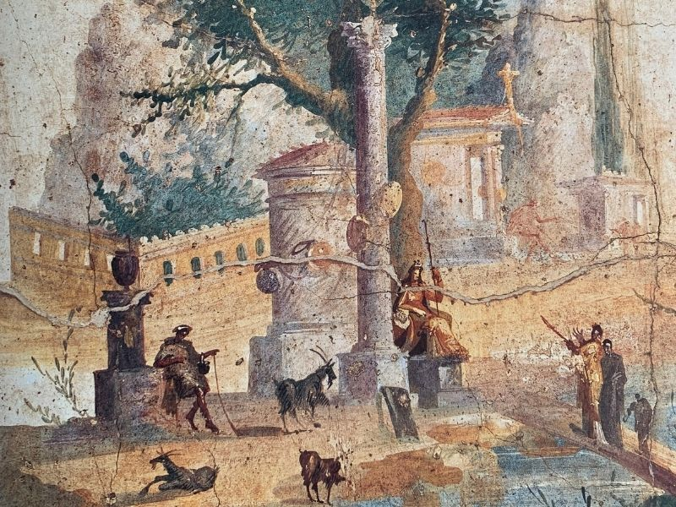
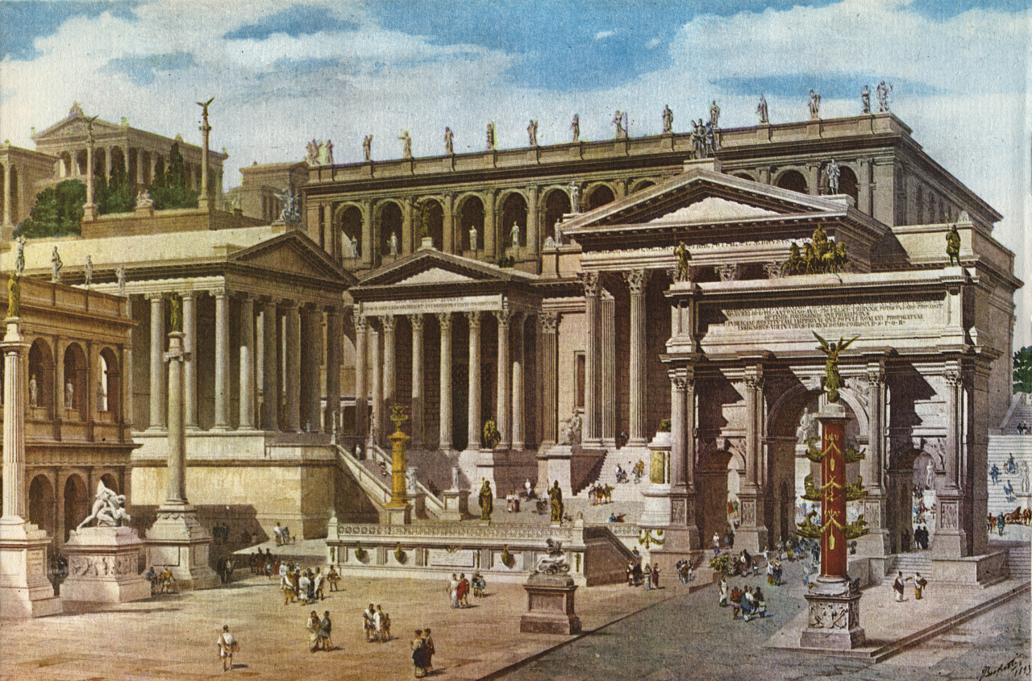
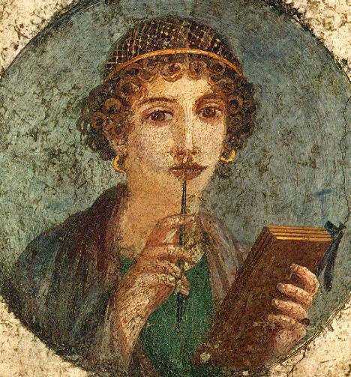
Latin in the TDSB
Saturday International Languages Credit Program
Take a time-travel trip with us!

Slide 2

The Saturday International Languages Program
Year-long credit courses in many different languages
Early October to late May
Three levels: B (grade 10), C (grade 11), D (grade 12)
Meetings from 9:00-12:30
No meetings on holiday weekends
Most languages are taught remotely, including Latin

Slide 3
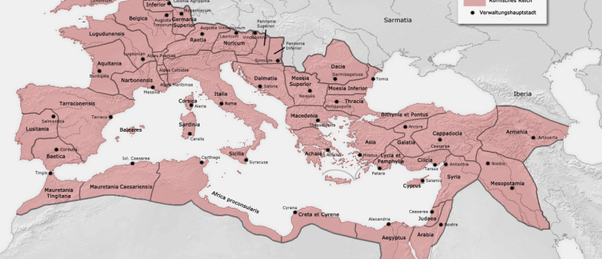
Improve your vocabulary
Improve your knowledge of grammar
Improve your memory and attention to detail
Improve your analytical skills
Learn about fascinating ancient civilizations whose customs and institutions are the basis of many modern ones
Enjoy Latin literature in its original form
Why Take Latin?

Slide 4
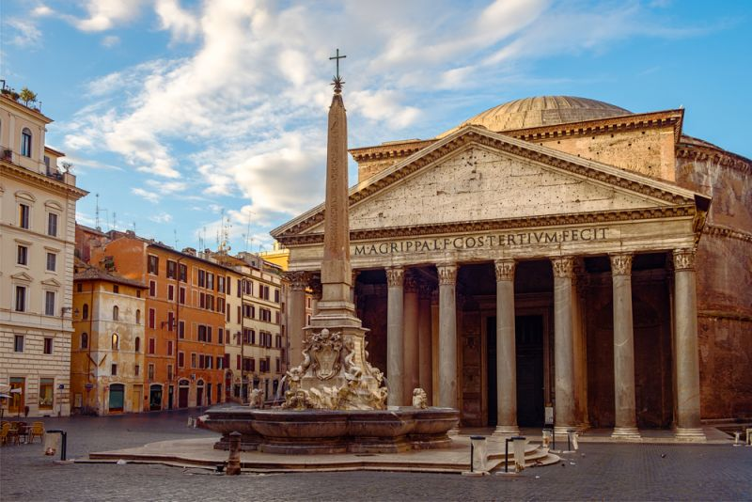
Greek and Roman literature, philosophy, art and architecture are the basis for all of these modern disciplines in the western world
Over 60% of English words are derived from Latin
The Romance languages (French, Spanish, Italian, Portuguese and Romanian) are descended from Latin
Most terms in the sciences are derived from Latin and Greek
Much legal terminology is based on Latin terms
Modern authors, composers and artists still base many works on Classical mythology and history
Classics is everywhere!

Slide 5

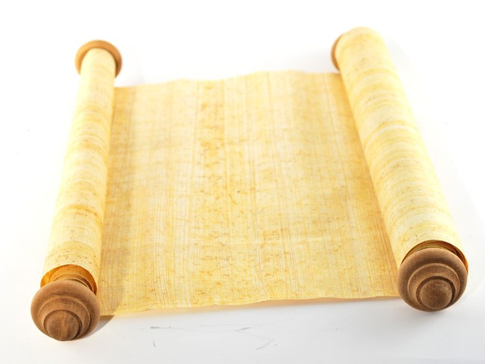
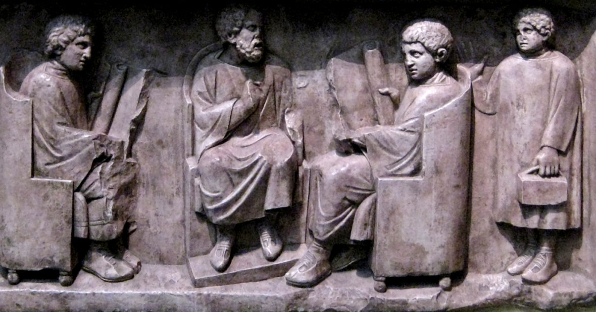
Latin Courses
Latin Year I (LVLBD: Academic)
Latin Year II (LVLCU: University Entrance)
Latin Year III (LVLDU: University Entrance)

Slide 6
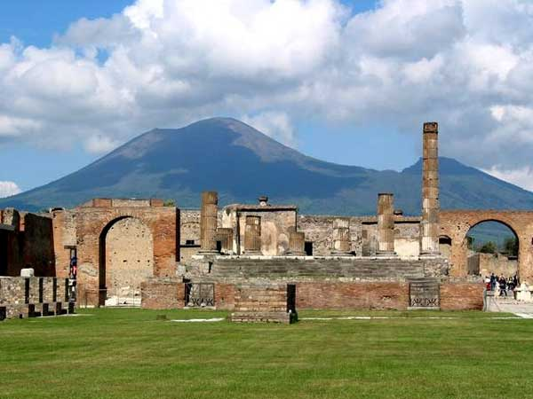
The Cambridge Latin Course
Combines study of Latin language, Roman culture, and English derivatives.
Uses the inductive method to engage students and improve thinking skills.
Unit 1 is set in Pompeii.

Slide 7
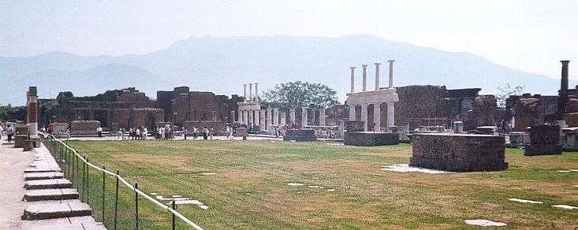
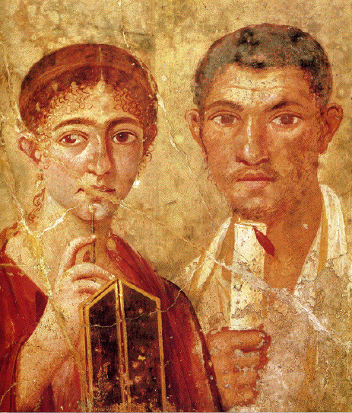
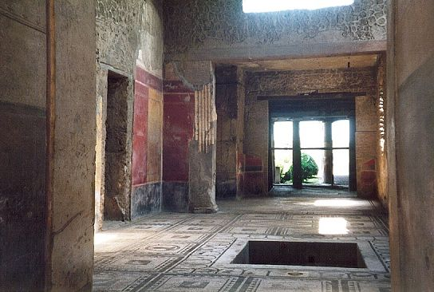
We follow an ancient Roman family through their daily life and special activities in Pompeii.

Slide 8
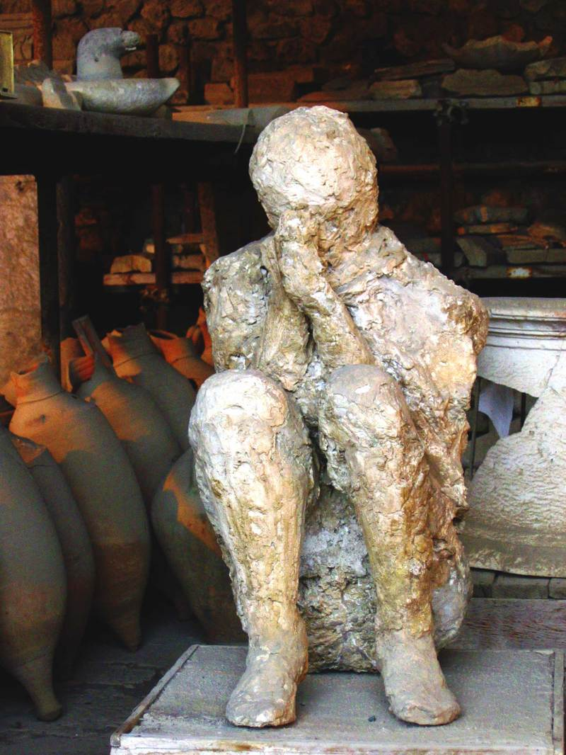
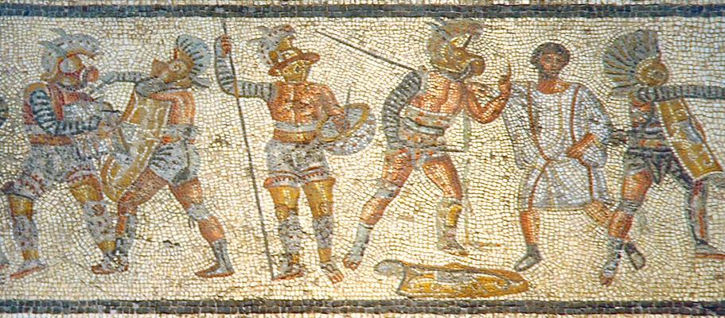
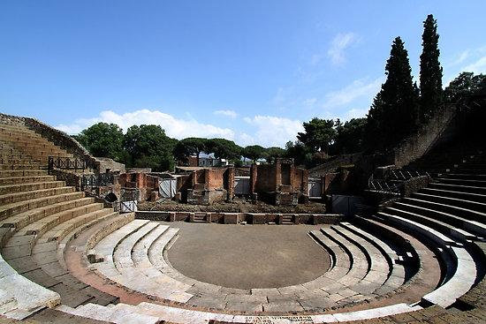
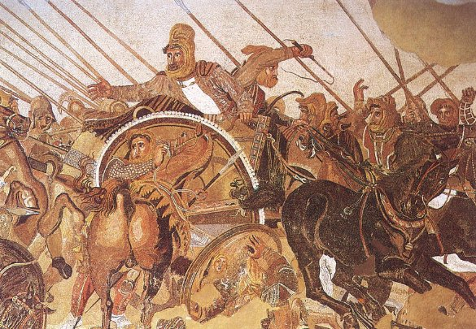
Students learn Latin while reading interesting, thought-provoking stories.

Slide 9
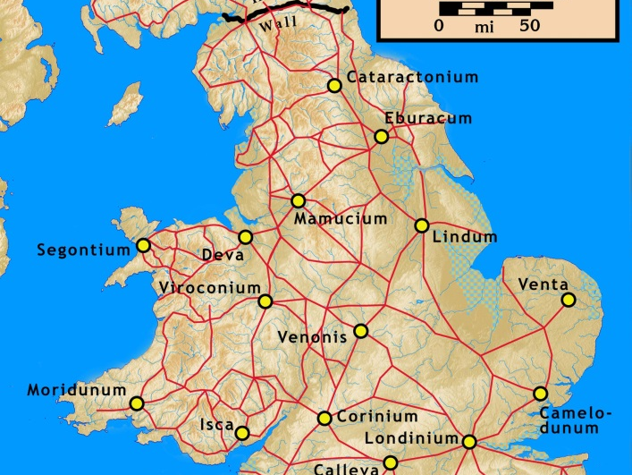
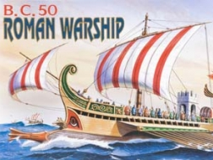
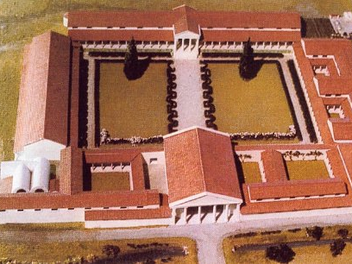
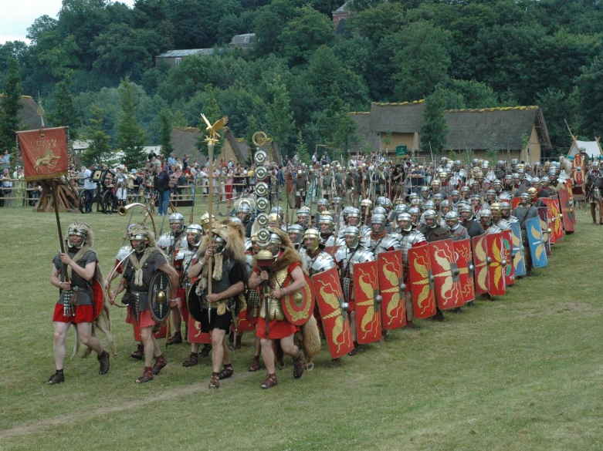
Later units take us to Roman Britain …

Slide 10
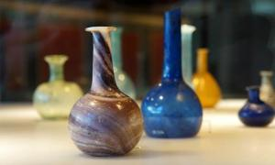
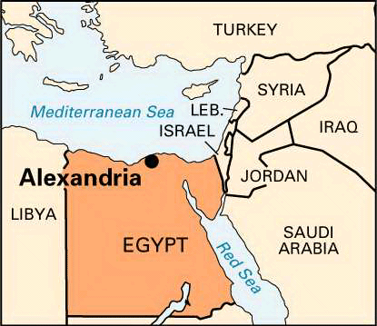
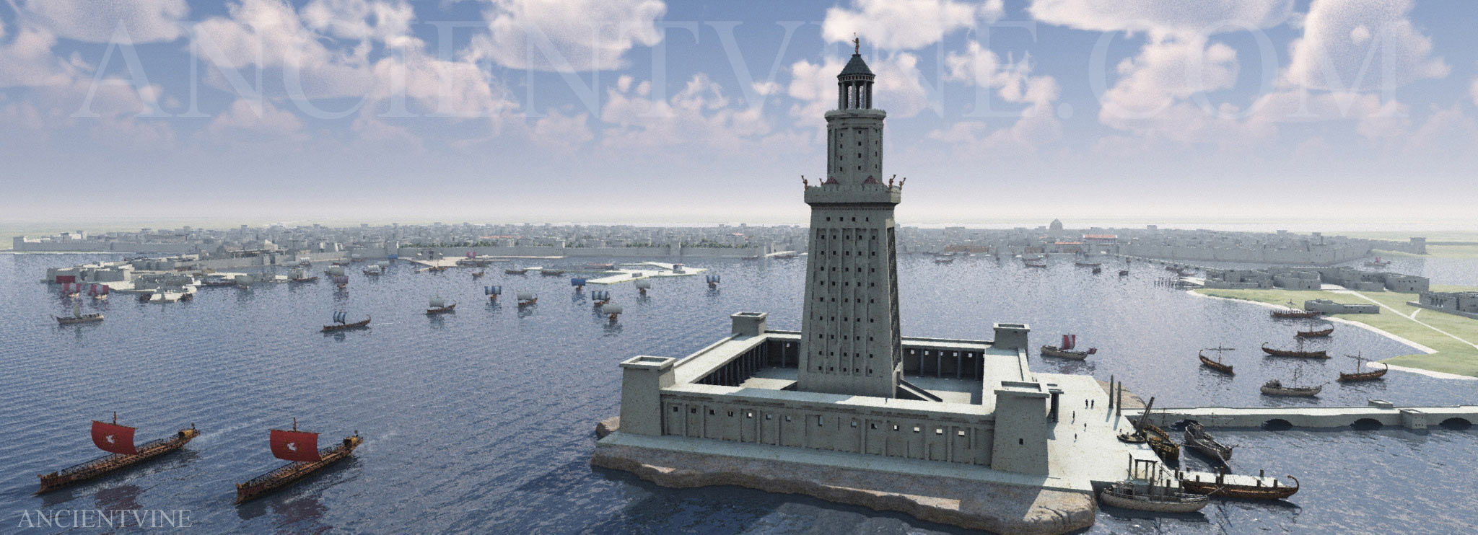
Alexandria in Egypt ...

Slide 11
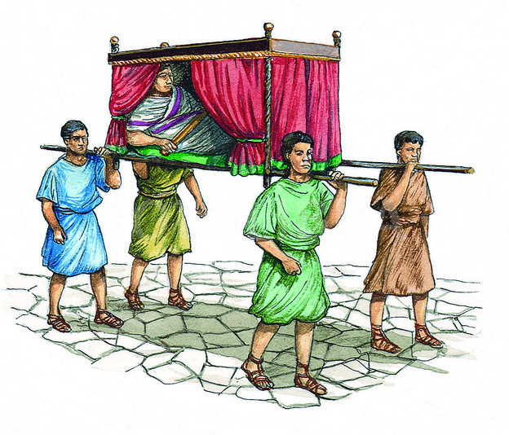
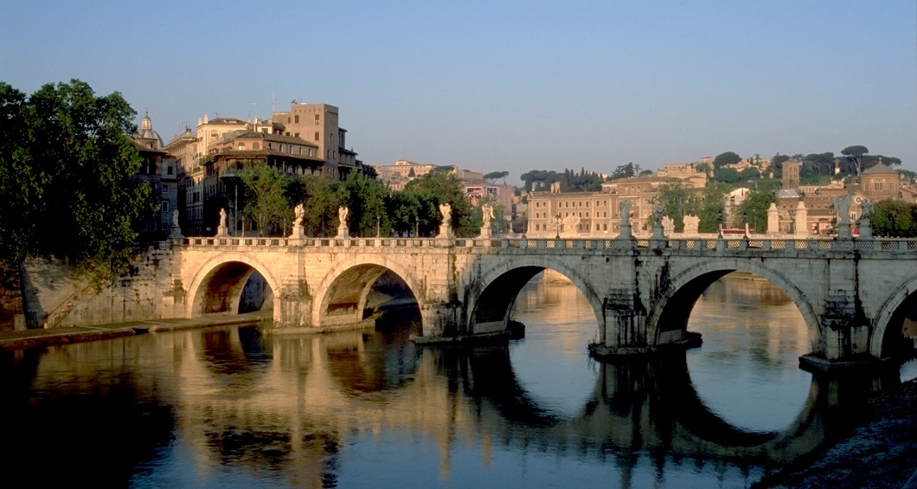
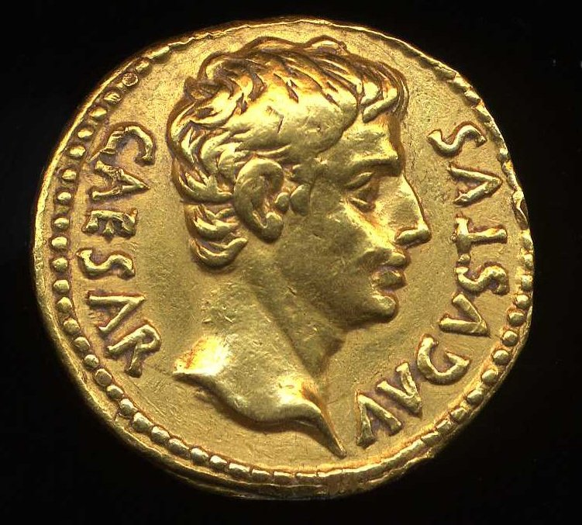
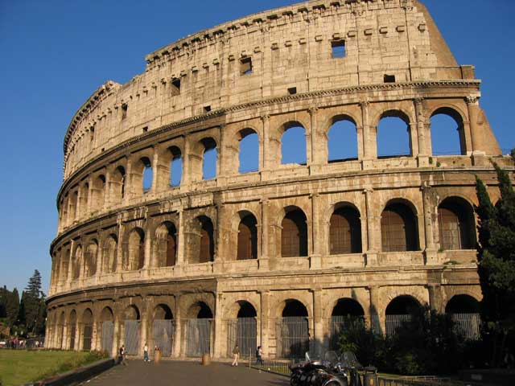
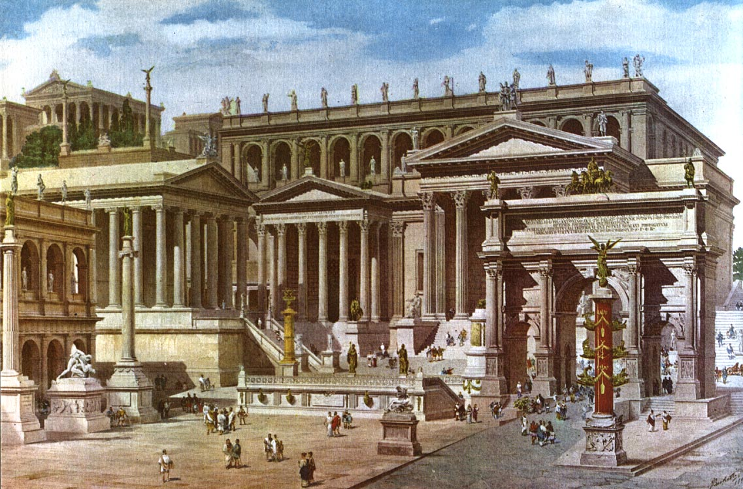
… and Rome itself.

Slide 12
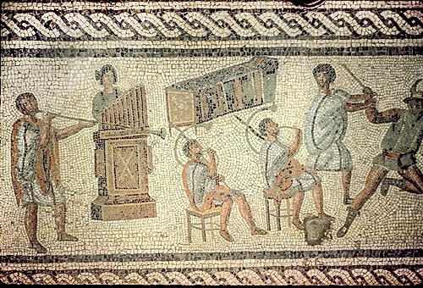
Activities and Assessments
Reading and translation of Latin stories that build up knowledge of vocabulary and grammar as well as cultural information
Supplementary reading of Latin literature in translation (novels, myths, poetry) in Years I and II
Study of Latin poetry (Year III)
Discussion of cultural topics
Study of Latin derivatives in English and other languages
Researched creative projects on topics of the student’s choice, in a wide range of media
Games to review knowledge
Translation into Latin
Writing of short original Latin stories
Dramatic reading of Latin stories
Tests and exams to evaluate linguistic knowledge

Slide 13
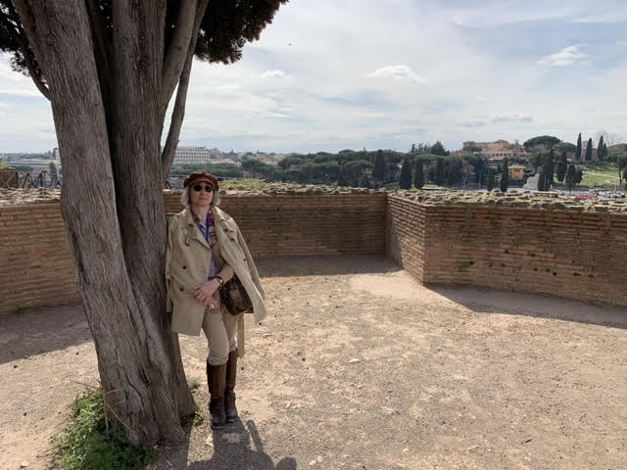
The Latin Teacher
Ms. Maggie Rogow taught Latin, ancient Greek and Classical Civilization in two TDSB schools for many years.
She ran a Classics Club at her day school.
She led several student trips to archaeological sites and museums in Italy.
She has an MA in Classics from the University of Toronto.
She loves to teach Latin!

