Slide 1
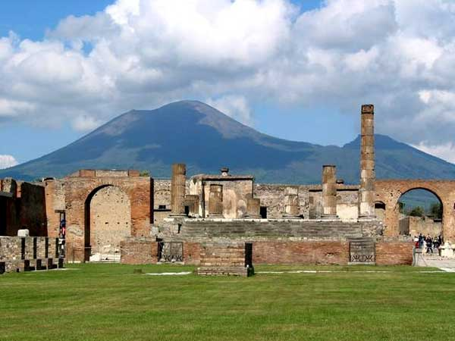
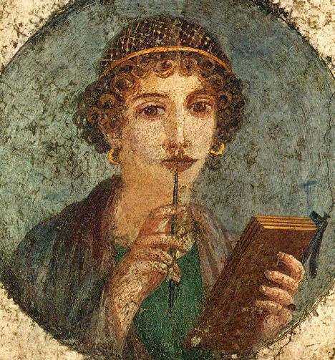
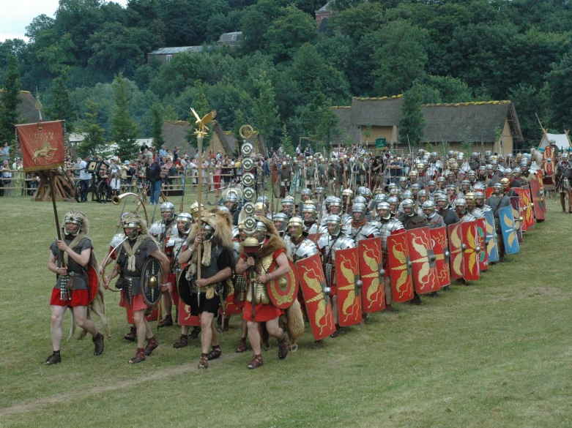
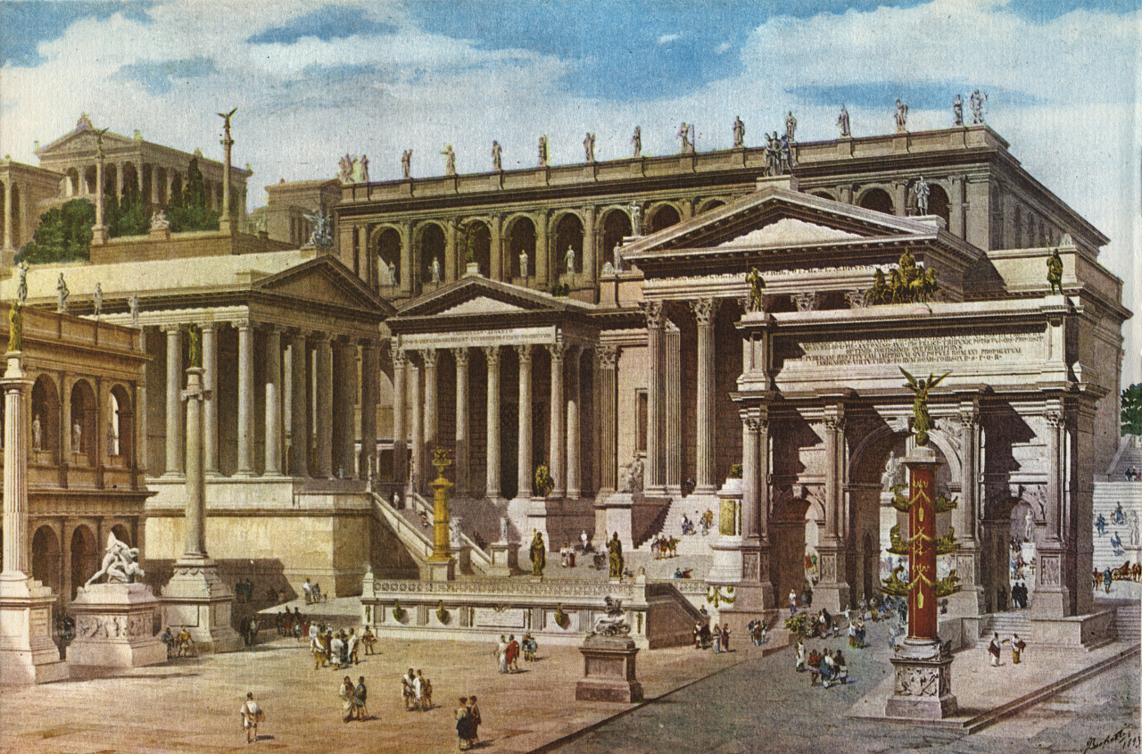
Latin in the TDSB
Saturday International Languages Credit Program
Take a time-travel trip with us!
Three levels: B (grade 10), C (grade 11), D (grade 12)
Taught remotely by Ms. Maggie Rogow, longtime TDSB Latin teacher
Engaging Latin stories and cultural readings
Learn to read Latin while improving your English vocabulary and grammar and your knowledge of history, culture and mythology

